Slide 1




BANK MARKETING
BFSI

Slide 2
THE CREW
SIVA KRISHNA
SURAMPUDI
VIVEK GUTTI
ABHISHEK
VINJARAPU
DINKAR CHAITANYA
JOSYULA
PRASHANTH PENDELA
ANIMESH TIWARI
Mentor

Slide 3
A GIST OF DOMAIN
Project Background:-
Nowadays, marketing expenditures in the banking industry are massive, meaning that it is essential for banks to optimize marketing strategies and improve effectiveness. Understanding customers’ need leads to more effective marketing plans, smarter product designs and greater customer satisfaction.
Main Objectives: -
Predict customers' responses to future marketing campaigns & increase the effectiveness of the bank's telemarketing campaign. This project will enable the bank to develop a more granular understanding of its customer base, predict customers' response to its telemarketing campaign and establish a target customer profile for future marketing plans.
Problem Statement..!
The data is related with direct marketing campaigns of a Portuguese banking institution. The marketing campaigns were based on phone calls. Often, more than one contact to the same client was required, in order to access if the product (bank term deposit) would be (or not) subscribed.

Slide 4
ROADMAP
EXPLORATORY
DATA ANALYSIS
HYPOTHESIS TESTING
BASELINE MODEL
1
2
3
2
DATA
ENSEMBLES
PERFORMANCE TUNING
5
4
PREDICTIONS
EVALUATION
6
7
BUSINESS SOLUTION

Slide 5
Dataset Description
Numerical | Description
Age | Age of client
Balance | Average yearly balance
Duration | Last contact duration
Pdays | Number of days that passed by after the client was last contacted from a previous campaign
Previous | Number of contacts performed before this campaign and for this client
Day | Last contact day of the month
Campaign | Number of contacts performed during this campaign and for this client
Categorical | Description
Job | Type of job
Martial | Marital status
Education | Level of education
Default | Has credit in default ?
Housing | Has housing loan ?
Loan | Has personal loan ?
Contact | Contact communication type
Month | Last contact month of year
Deposit | Has the client subscribed a term deposit ?
Poutcome | Outcome of the previous marketing campaign

Slide 6




SWOT ANALYSIS
STRENGTH
WEAKNESS
Can Understand the Demographics patterns of the customers.
No missing values
Imbalanced data.
Having outliers in the data set.
Having many unknown in subcategories of the data set.
When a subscriber is classified as a non-subscriber it can lead to a bad customer experience (basically wrong conclusions) and it can be a loss to business.
Study the hidden patterns in demographics and make relevant recommendation to the business
OPPORTUNITY
THREATS

Slide 7
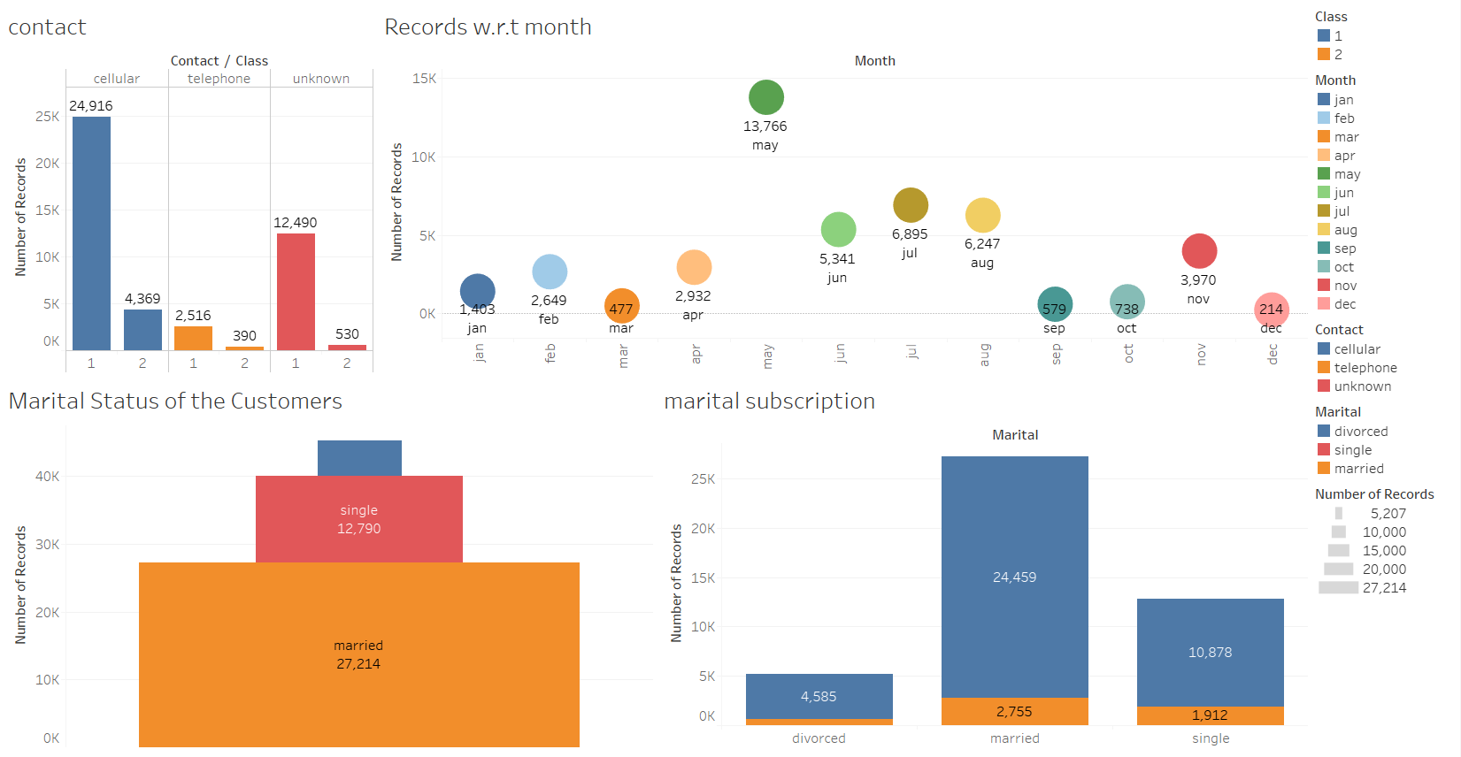
EXPLORATORY DATA ANALYSIS

Slide 8
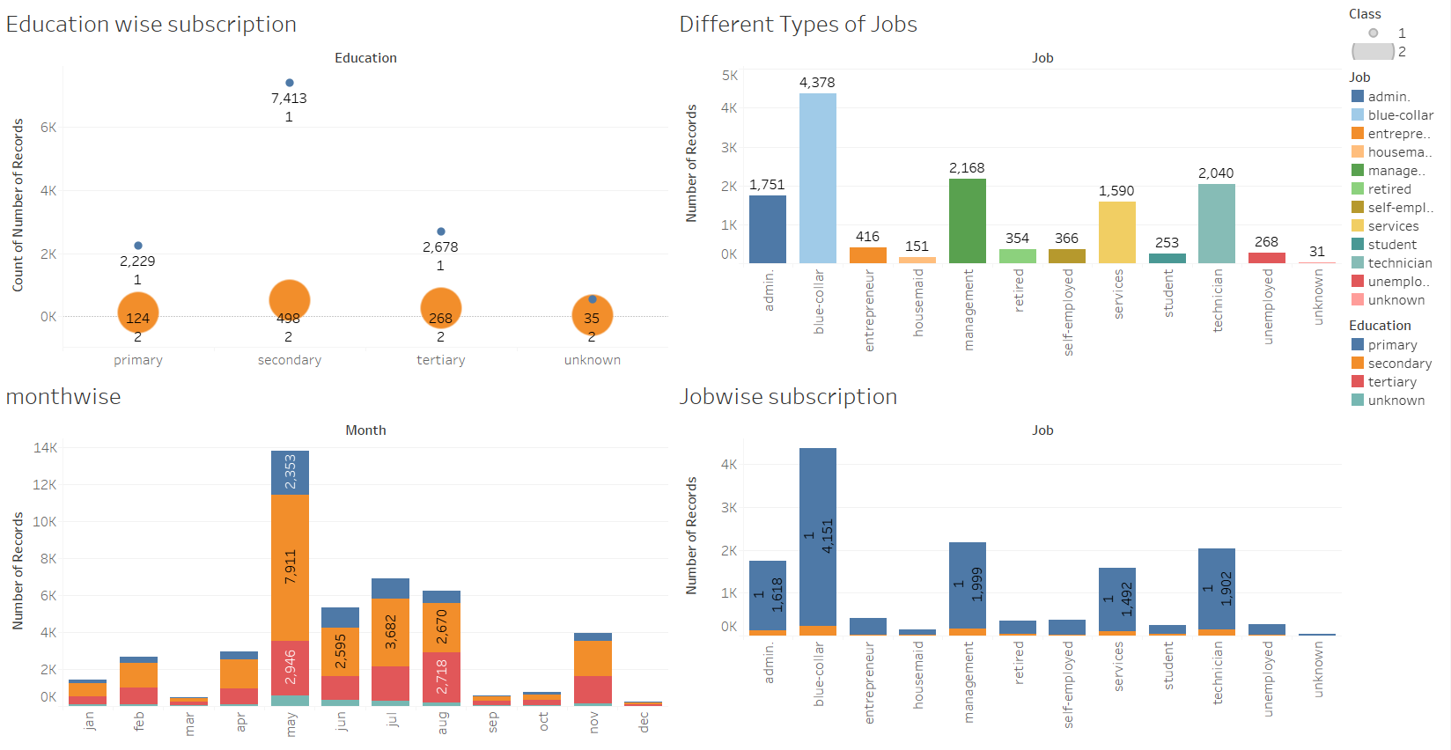
EXPLORATORY DATA ANALYSIS

Slide 9
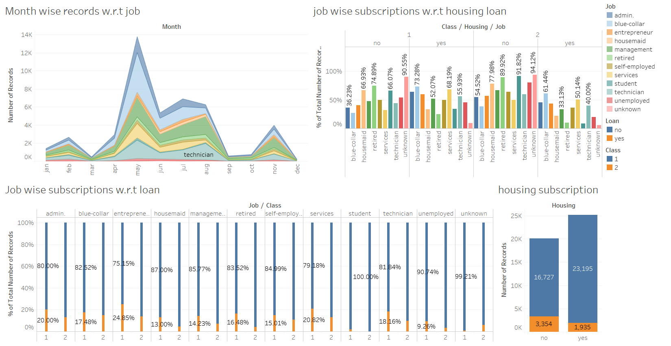
EXPLORATORY DATA ANALYSIS

Slide 10
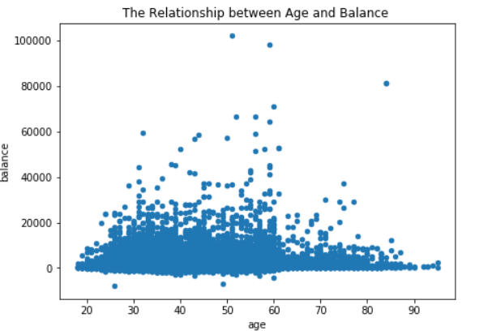
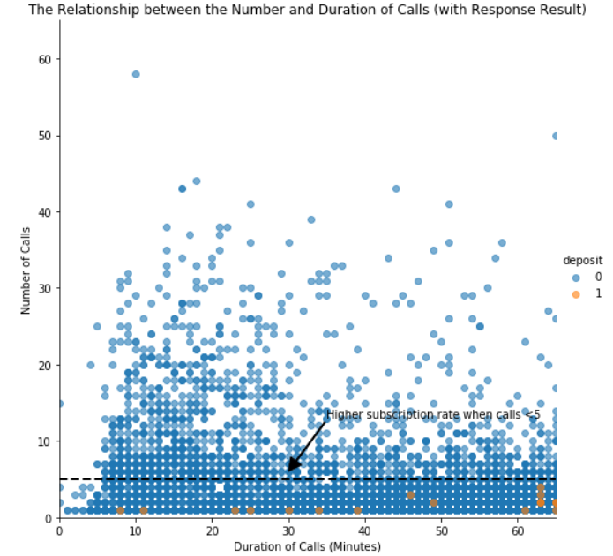
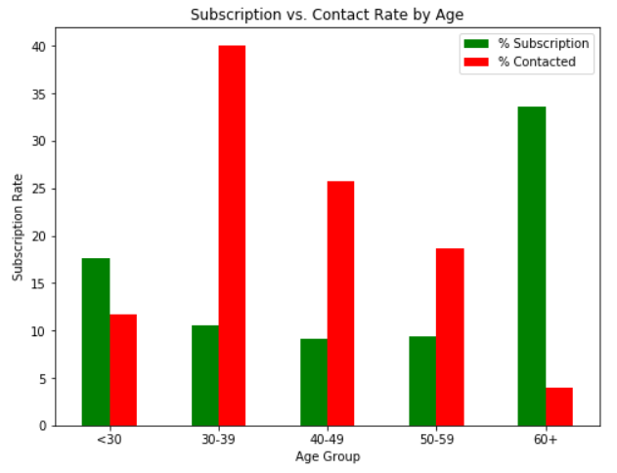
EXPLORATORY DATA ANALYSIS

Slide 11
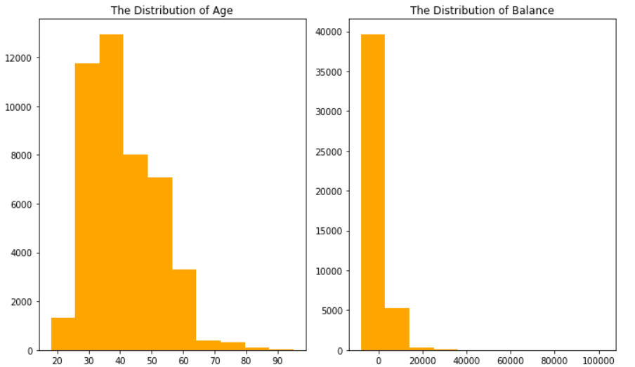
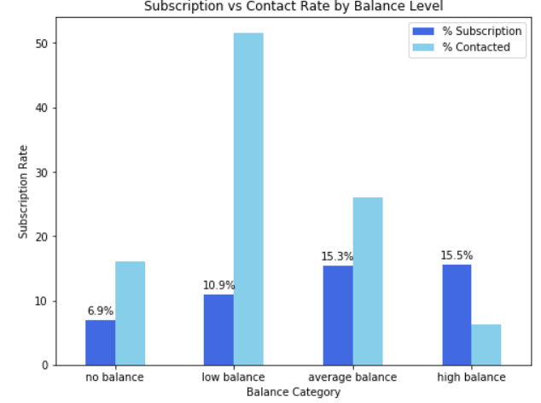
EXPLORATORY DATA ANALYSIS

Slide 12
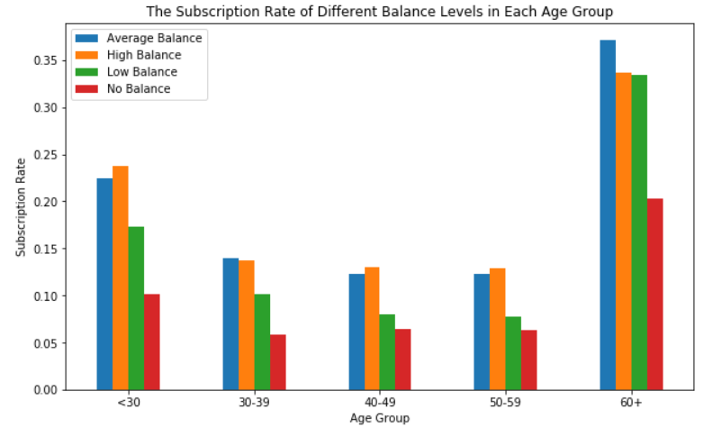
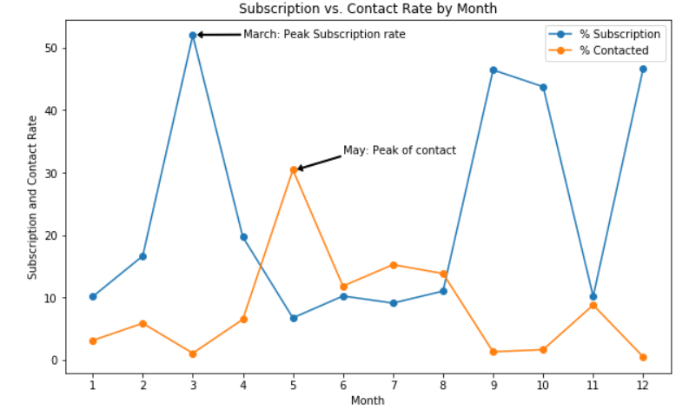
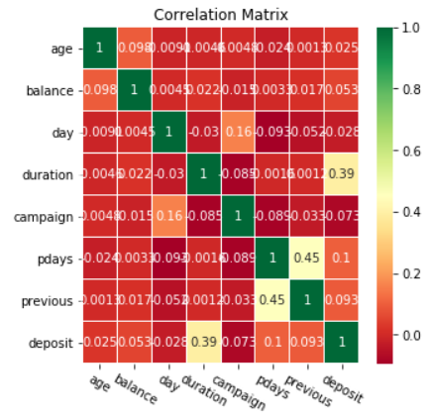
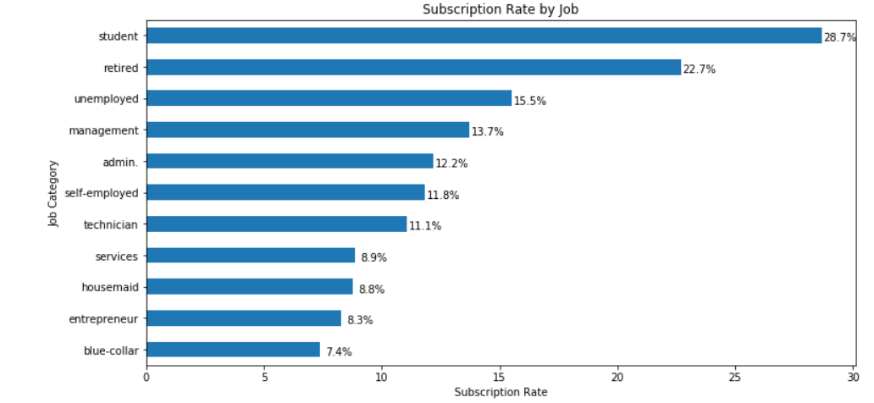
EXPLORATORY DATA ANALYSIS

Slide 13
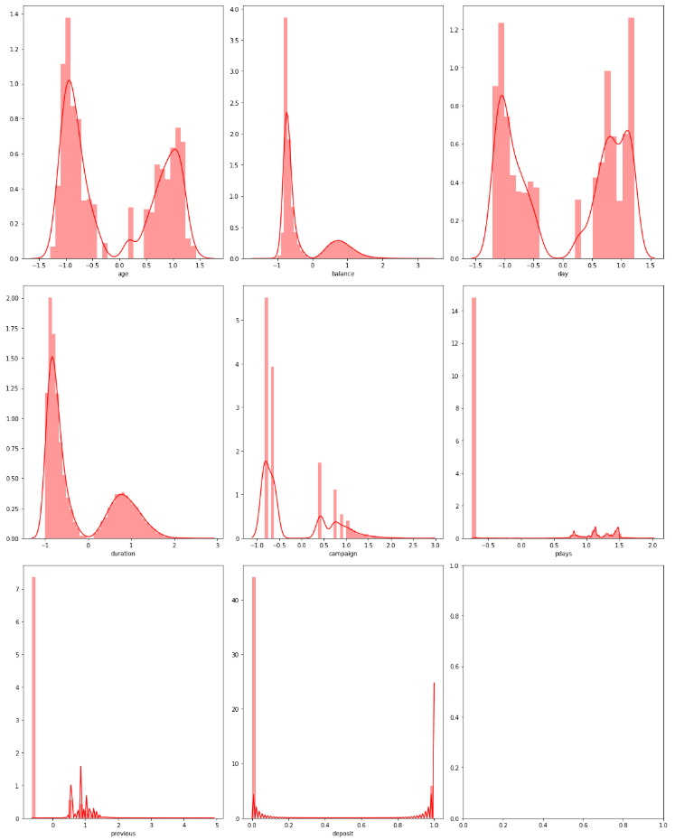
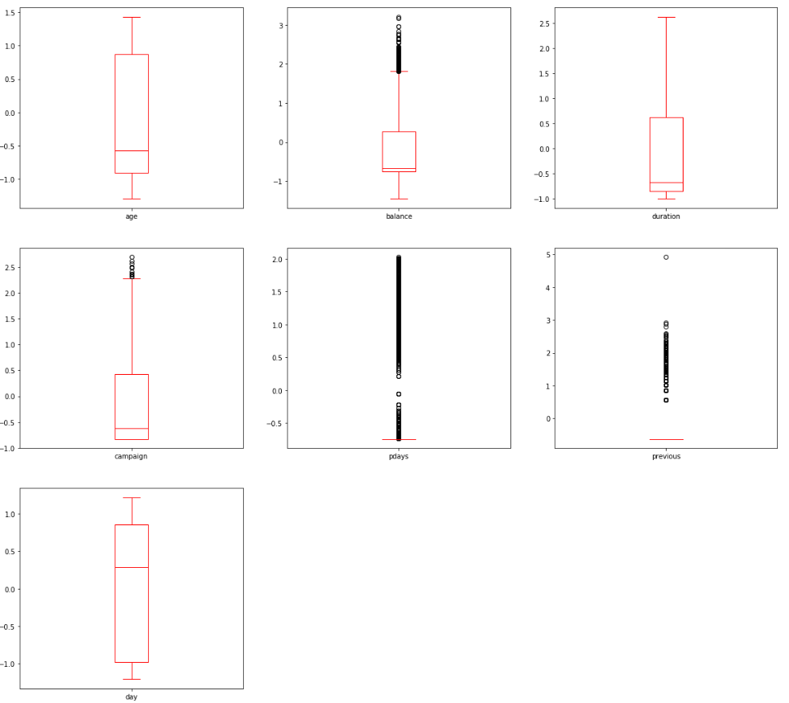
EXPLORATORY DATA ANALYSIS
NORMALITY & OUTLIERS OF THE FEATURES AFTER OUTLIER’S TREATMENT

Slide 14
EXPLORATORY DATA ANALYSIS
HYPOTHESIS TESTING RESULTS
Variable | P value | Decision
Age | 0.009 | Reject H0
Balance | 0.000 | Reject H0
Day | 0.691 | Fail to reject H0
Duration | 0.000 | Reject H0
Campaign | 0.000 | Reject H0
Pdays | 0.000 | Reject H0
Previous | 0.066 | Fail to reject H0
job_blue-collar | 0.000 | Reject H0
job_entrepreneur | 0.000 | Reject H0
job _housemaid | 0.000 | Reject H0
job_management | 0.000 | Reject H0
job_retired | 0.367 | Fail to reject H0
job_self-employed | 0.000 | Reject H0
Variable | P value | Decision
job_services | 0.001 | Reject H0
job_student | 0.011 | Reject H0
job_technician | 0.000 | Reject H0
job_unemployed | 0.001 | Reject H0
Marital_married | 0.000 | Reject H0
Marital_single | 0.259 | Fail to reject H0
Education secondary | 0.716 | Fail to reject H0
EducationTertiary | 0.002 | Reject H0
Default_yes | 0.197 | Fail to reject H0
Housing_yes | 0.000 | Reject H0
Loan_yes | 0.000 | Reject H0
Contact_ telephone | 0.124 | Fail to reject H0
Contact_ unknown | 0.000 | Reject H0
Variable | P value | Decision
Month_aug | 0.000 | Reject H0
Month_dec | 0.006 | Reject H0
Month_feb | 0.002 | Reject H0
Month_jan | 0.000 | Reject H0
Month_jul | 0.000 | Reject H0
Month_jun | 0.001 | Reject H0
Month_mar | 0.000 | Reject H0
Month_may | 0.000 | Reject H0
Month_nov | 0.000 | Reject H0
Month_oct | 0.000 | Reject H0
Month_sept | 0.000 | Reject H0
Poutcome_other | 0.583 | Fail to reject H0
Poutcome Success | 0.000 | Reject H0
Poutcome Unknown | 0.000 | Reject H0

Slide 15
EXPLORATORY DATA ANALYSIS
MULTICOLLINEARITY RESULTS
Variable | VIF | Decision
Age | 1.191235 | Vif<4
Balance | 1.254509 | Vif<4
Duration | 1.095079 | Vif<4
Campaign | 1.172748 | Vif<4
Pdays | 9.854012 | Vif>4
job_blue-collar | 2.400730 | Vif<4
job_entrepreneur | 1.253233 | Vif<4
job _housemaid | 1.169404 | Vif<4
job_management | 3.208361 | Vif<4
job_self-employed | 1.266121 | Vif<4
job_services | 1.568416 | Vif<4
job_student | 1.175649 | Vif<4
job_technician | 2.050722 | Vif<4
Variable | VIF | Decision
job_unemployed | 1.183071 | Vif<4
Marital_married | 2.791225 | Vif<4
EducationTertiary | 2.680599 | Vif<4
Housing_yes | 3.126247 | Vif<4
Loan_yes | 1.255778 | Vif<4
Contact_ unknown | 3.292653 | Vif<4
Month_aug | 3.120586 | Vif<4
Month_dec | 1.069575 | Vif<4
Month_feb | 1.697968 | Vif<4
Month_jan | 1.369884 | Vif<4
Month_jul | 3.205897 | Vif<4
Month_jun | 3.354037 | Vif<4
Variable | VIF | Decision
Month_mar | 1.141809 | Vif<4
Month_may | 6.000556 | Vif>4
Month_nov | 2.074751 | Vif<4
Month_oct | 1.215499 | Vif<4
Month_sept | 1.176379 | Vif<4
Poutcome Success | 1.227866 | Vif<4
Poutcome Unknown | 36.643430 | Vif>4

Slide 16
EXPLORATORY DATA ANALYSIS
EVALUATION METRICS
Proportion of correctly identified instances
F1
SCORE
Proportion of predicted positives
RECALL
ACCURACY
PRECISION
Harmonic mean of Precision and Recall
Proportion of Actual positives predicted correctly

Slide 17
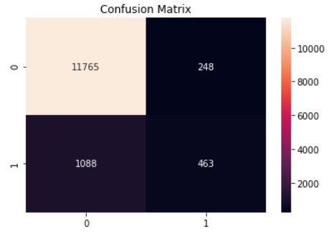
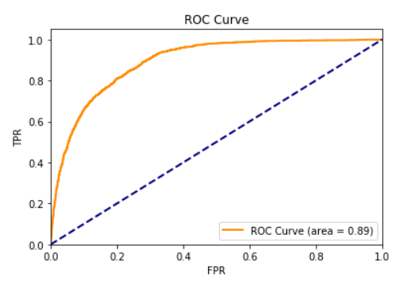
BASELINE MODEL
Logistic Regression Metrics (Imbalanced Data)
Accuracy | 0.9015039811265113
Precision | 0.6511954992967651
Recall | 0.2985170857511283
F1-Score | 0.4093722369584439

Slide 18
COMING PROGRESSION
CROSS VALIDATION
GUESSTIMATE
AND
BUSINESS SOLUTION
DATA BALANCING
K-Fold (check of bias & variance error)
UNDER SAMPLING, OVER SAMPLING
ENSEMBLING
BOOSTING, BAGGING

Slide 19

LET’S CLARIFY
THANK YOU

